Slide 1


Ride Share Mania
Done By:
Victor Galstyan
Ruddy SimonpouR
Moumita Ghanti
Ghaith Ramahi

Slide 2
Motivation & Summary
Discover hidden trends under certain circumstances; such as:
Weather factors (Temperature & Humidity)
Time of Day (Morning, Afternoon, Evening, Night)
SR_Flag (Pool vs Non-pool)
Regression Analysis of Progression of Time vs Trip Count
We want to see if there is a relationship between Number of Rides and Trip Duration and the above variables.

Slide 3
Questions & Data
The Temperature affects the number of ride share rides requested.
Null Hypothesis: There is no relationship between the number of ride share rides requested and the temperature.
The Humidity affects the number of ride share rides requested.
Null Hypothesis: There is no relationship between the number of ride share rides requested and the humidity.
Time of the day affects the number of the ride share rides placed.
Null Hypothesis: The time of day has no effect on the number of ride share rides placed.
Time of Day impacts the Trip Duration of ride share rides.
Null Hypothesis: Time of Day has no effect on the Trip Duration of rides.
The SR_Flag, or type of ride share ride, impacts the Ride Counts.
Null Hypothesis: Trip Duration is not affected by the SR_Flag, or type of ride share ride.
The frequency of ride share rides increases, in the time of day, as time progresses.
Null Hypothesis: There is no difference of ride share frequency service as time progresses.

Slide 4
Data Cleanup & Exploration
Our raw data was obtained from the NYC Taxi & Limousine Commission, which contained Uber and Lyft trip information.
https://www1.nyc.gov/site/tlc/about/tlc-trip-record-data.page
We used OpenWeather to obtain historical weather data for NYC.
We obtained Zip Code data by inputting the Borough and Zone of the trip into the Google Maps API.
We used Pandas to merge the trip data for each month and then removed any null or N/A records from the data.
After cleaning the data we took a random sample of the yearly data file.
We then separated the yearly file into monthly files.
The type of data we needed to address our hypothesis?
Trip Data
Weather factors (Temp & humidity)
Time of the day\day of the week.
Location
The process for creating the final analysis file is as follows:
The random sample of the monthly trip data was merged with the Weather Data for that month and with the Location Data for that month.
Once the data was merged together we saved each completed file as RideShare_Data_YearMonth. This is file we used for our data analysis.

Slide 5
Data Analysis
All the data analyzed will be present on the coming slides.
We tested 6 different hypothesis
We want to share the results we came to conclude.

Slide 6


Weather and the Frequency of Rides
There are correlations between the weather and the frequency of Uber rides placed.
Null Hypothesis: There is no relation between the frequency of ride share and the weather.
During the extreme weather , the ride counts are significantly less than normal weather
During rainy weather, the percentage of rides is more on Sunday (May be due less frequency of subways or other transportation)

Slide 7
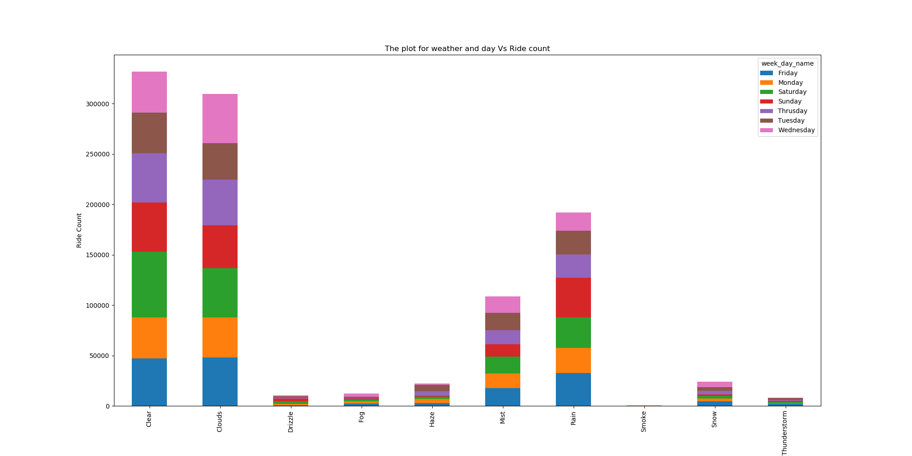
Type of Weather and the Frequency of Rides

Slide 8
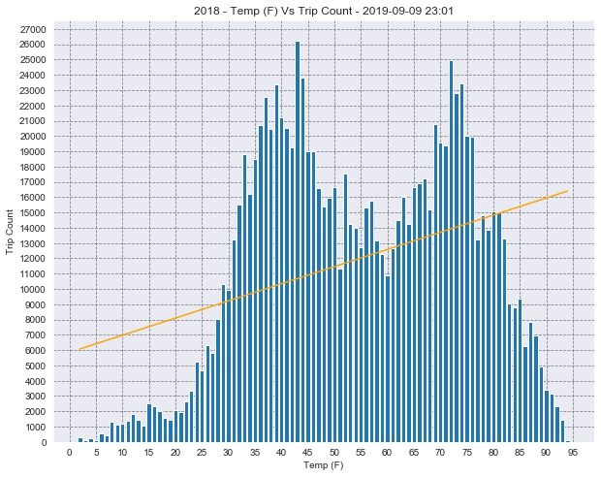
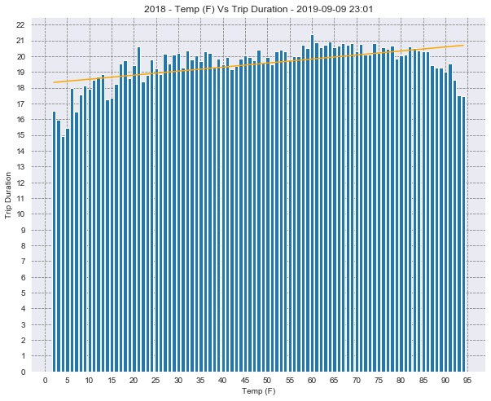
Temperature vs trip count & trip duration
The P Value for Temperature and trip duration was not significant
The P Value for Temperature and trip count was significant

Slide 9
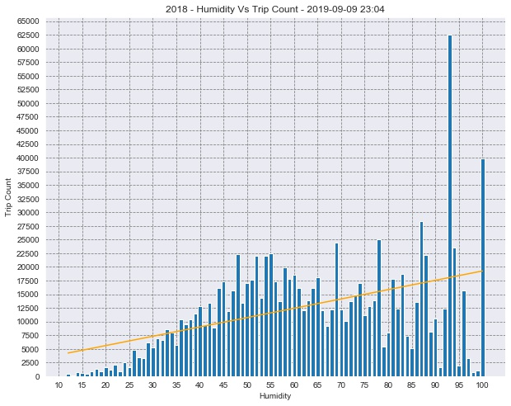
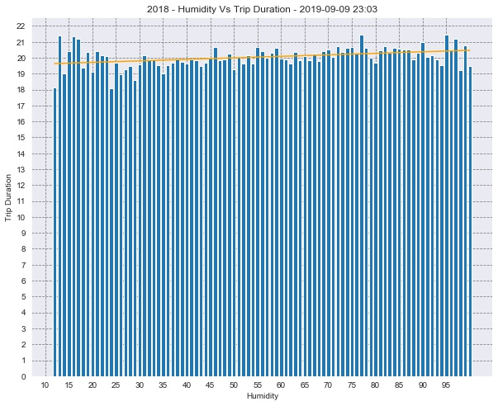
Humidity vs trip count & trip duration
The P Value for Humidity and trip duration was not significant
The P Value for Humidity and trip count was significant

Slide 10
Time of Day vs Frequency of Rides
Time of day affects the frequency of uber rides placed.
Null Hypothesis: The time of day has no effect on the ride share ride placed.
The morning rides are less in weekend vs. weekdays.
The afternoon rides increases in the weekends.
Night and Evening rides have more variation between weekends and weekdays

Slide 11
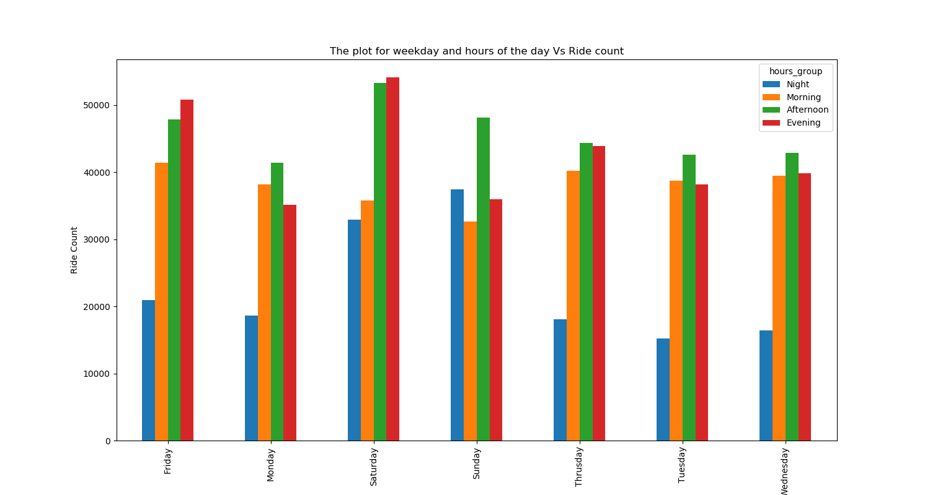
Time of Day vs Frequency of Rides

Slide 12
Time of Day vs Trip Duration
Time of Day impacts the Trip Duration of ride share rides.
Null Hypothesis: There is no effect on trip duration throughout the time of the day.

Slide 13
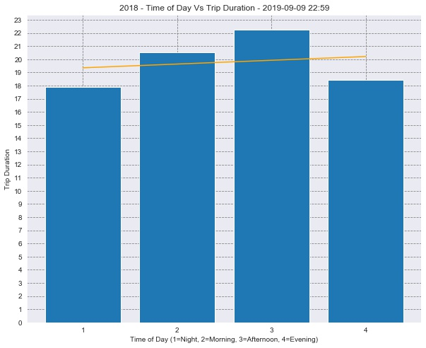
Time of Day vs Trip Duration

Slide 14
SR_Flag vs Ride Counts
The SR_Flag, or type of ride share ride, impacts the Ride Count
Null Hypothesis: Ride Count is not affected by the SR_Flag, or type of share ride.
SR_Flag
Indicates if the trip was a part of a shared ride chain offered by a High Volume FHV company (e.g. Uber Pool, Lyft Line). For shared trips, the value is 1. For non-shared rides, this field is null.
Conclusion:
The ride count is more for SR_Flag “0” and less for “1”(shared rides)
The ride count distribution of SR_Flag (“0” and “1”) does not drastically vary among the zip codes.

Slide 15
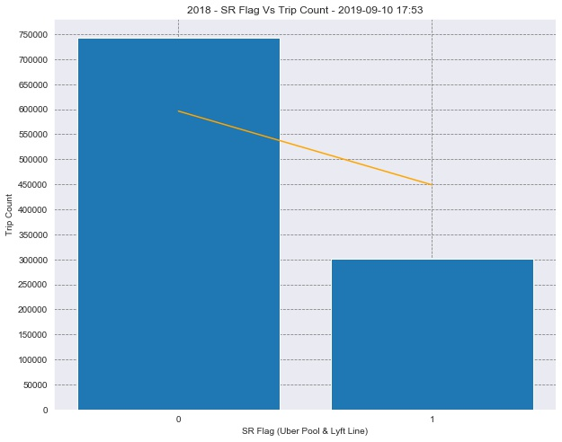
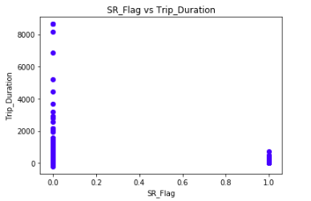
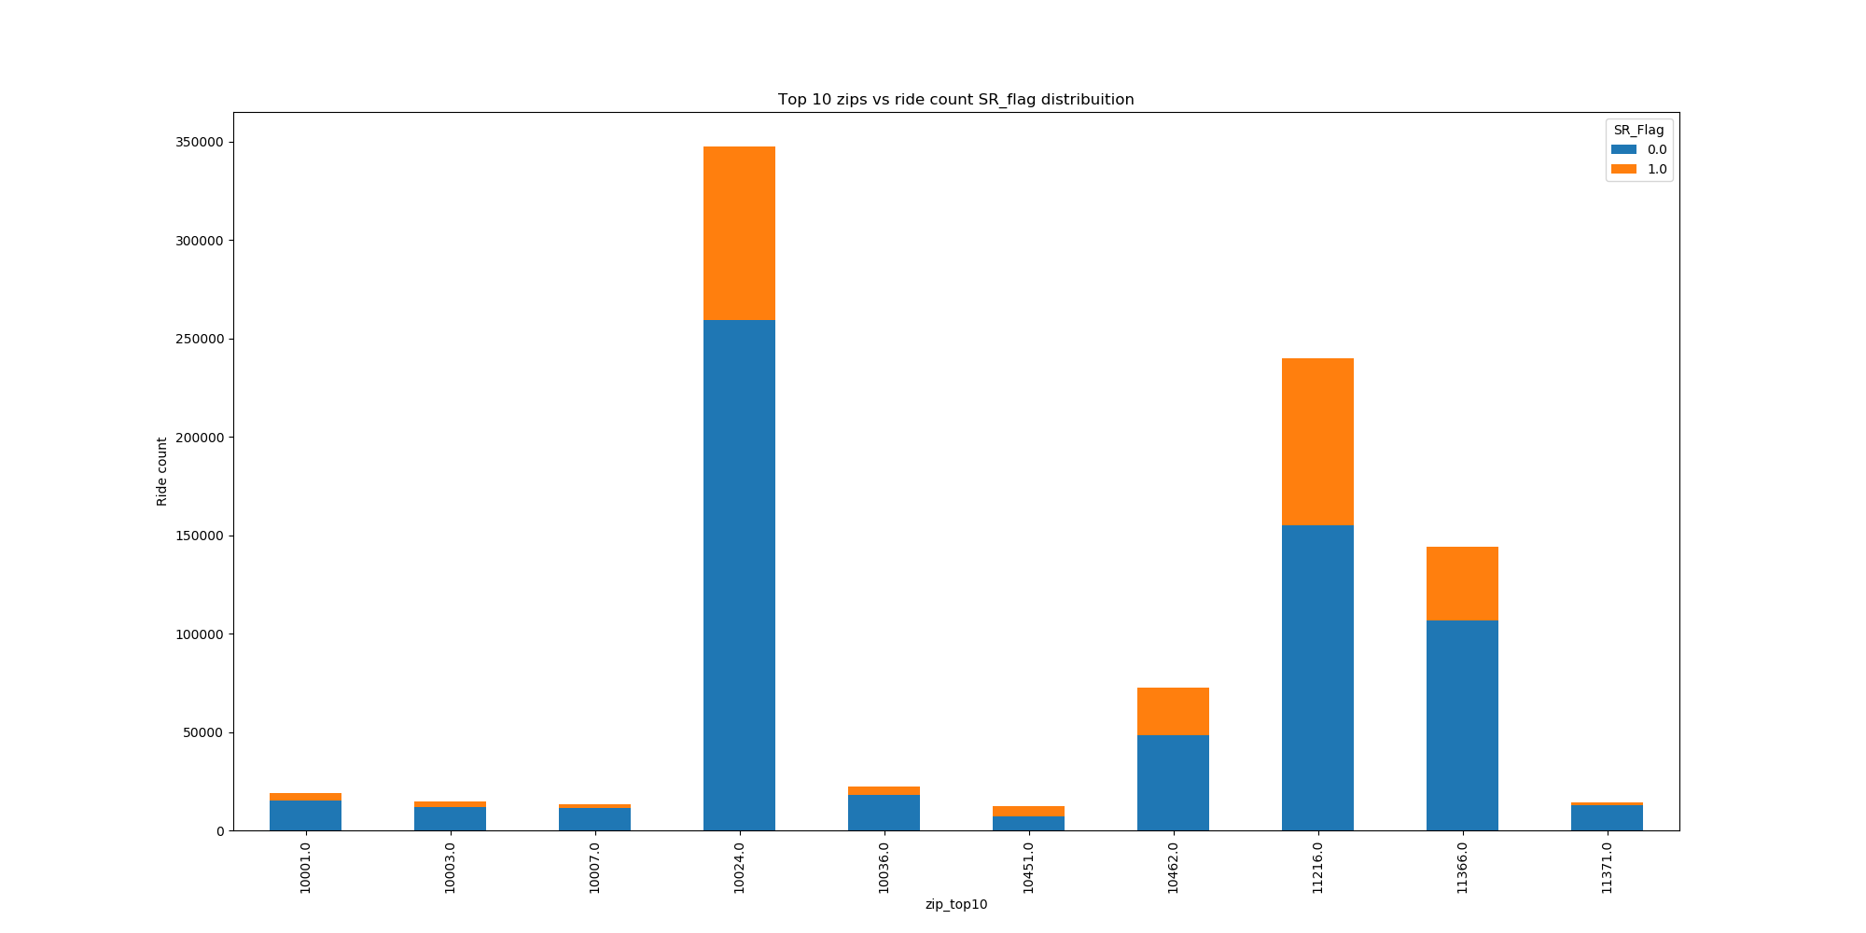
SR_Flag vs Ride Counts

Slide 16
Linear Regression (Past vs Future)
The frequency of ride share increases, in the time of day, as time progresses.
Null Hypothesis: There is no difference of ride share frequency service as time progresses.
The number of rides from 2017 to 2018(end) is increasing . Hence the prediction for 2019 the number of rides will increase.
Prediction counts for 2019
The morning count in 2019 will be 22532.895987852593.
The afternoon count in 2019 will be 27903.43025254272.
The evening count in 2019 will be 25985.051100858487.
The night count in 2019 will be 13716.751122133079.
The total count in 2019 will be 90138.12846338749.
The variation of the ride counts is very little during the morning and night hours(12 AM to 12 PM). But the number of rides consistently increases during the afternoon and evening hours.
(Perhaps suggests routine rides like office does not affect the trend prediction )

Slide 17
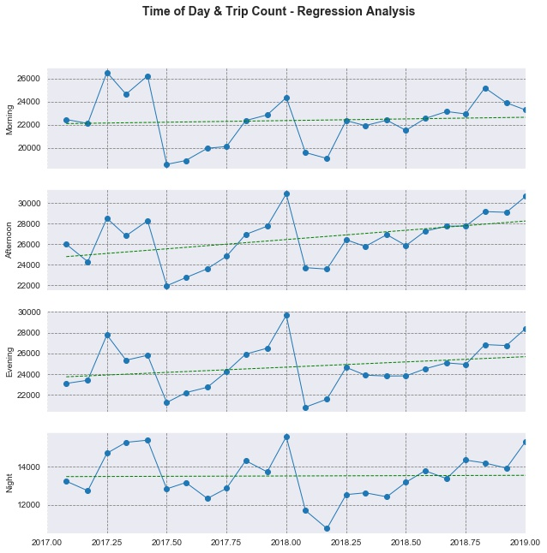
Linear Regression (Past vs Future)

Slide 18
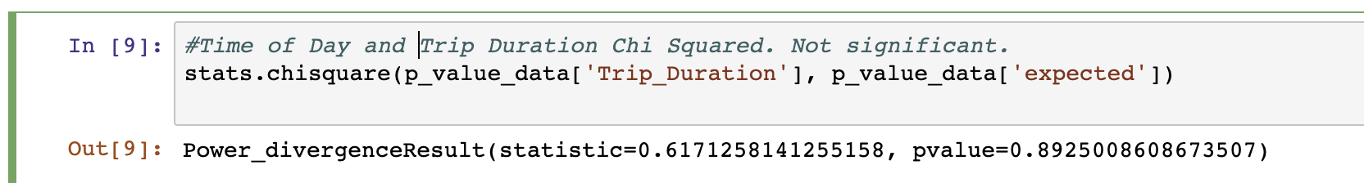
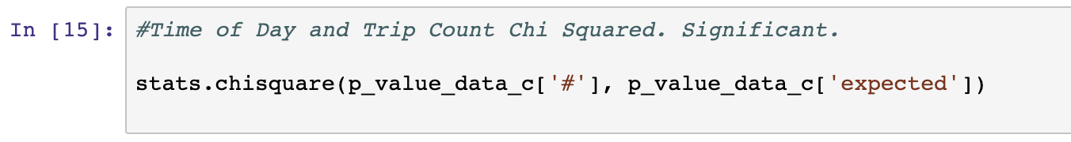
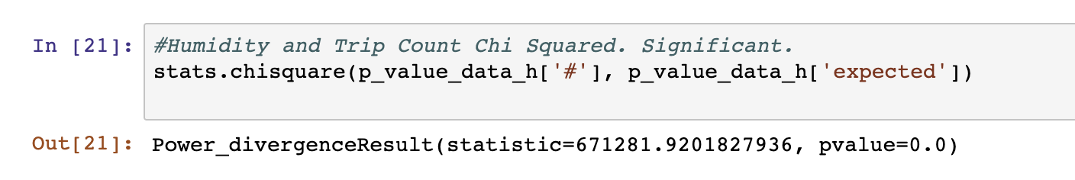
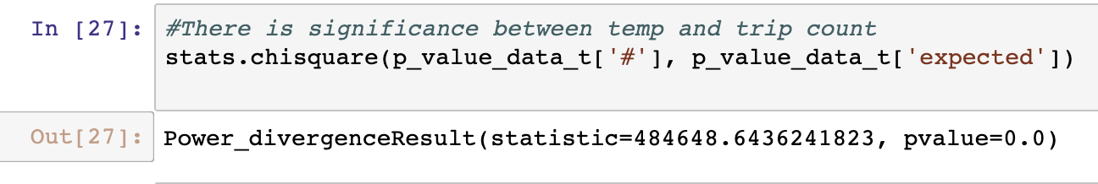
P-Value Test Results

Slide 19
Discussion
The Time of Day and Trip Count regression analysis showed a strong correlation of an increasing trend going into the future.
We did not find any strong correlations between any of our variables tested and the trip duration.
The trip count had the strongest correlation to our variables.
Temperature
Humidity
Time of Day

Slide 20
Post Mortem
Issues to figure out the correct sampling process and what correlations we may be able to draw from our obtained sets of Data.
Uber locked their hailing ride share data, so we couldn’t access the Data straight from Uber or Lyft. Luckily we had nyc.gov.
Sorting and converting strings to integers.
Slicing the the 24 hours in a day to 4 different bins to obtain the hour groups and to also draw correlation from it.

Slide 21
Questions
Open-floor, Questions and Answers with the audience.

